Slide 1
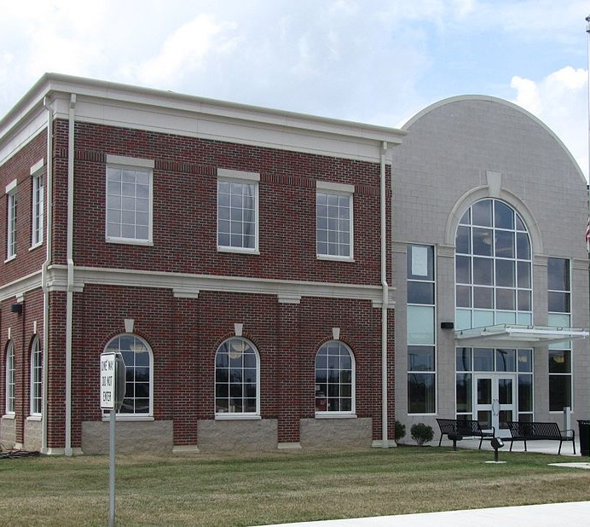
COVID-19 from two perspectives – CIO & CEO
March 2019 - March 2020

Slide 2
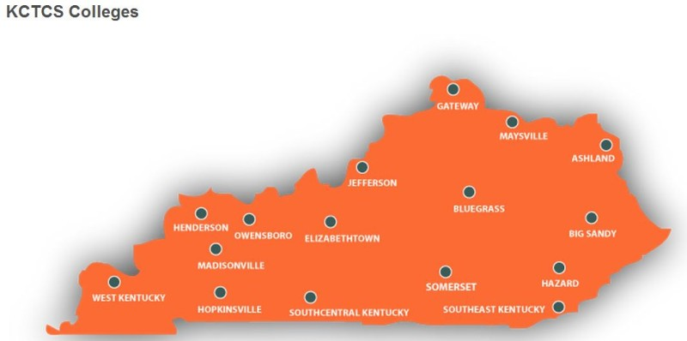
KCTCS PRofile
System of 16 accredited colleges and 70 locations across the state of Kentucky
Serves more than 100,000 credit and 45,000 workforce students annually
The Colleges range in size and serve urban and rural populations
Each College’s region has different challenges and opportunities

Slide 3
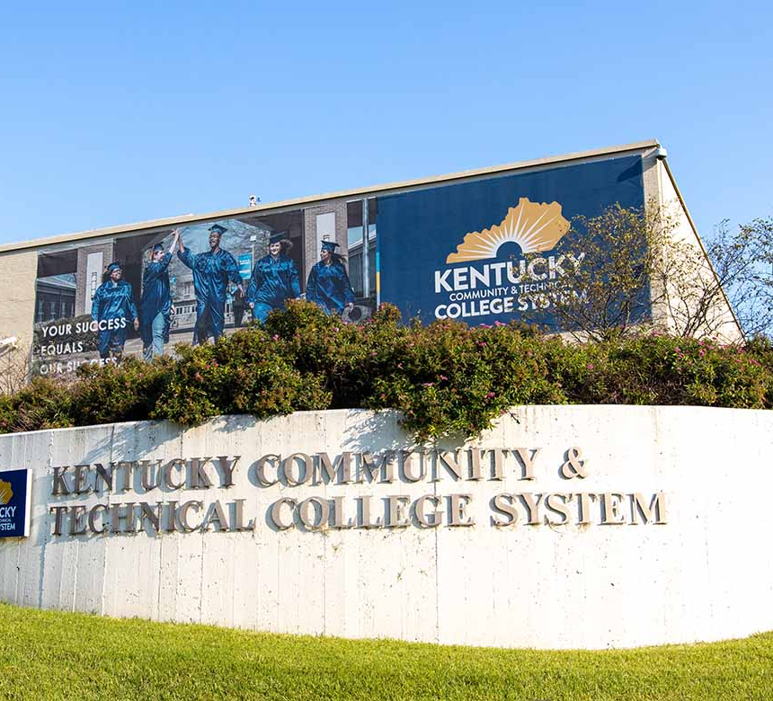
System office
The System Office is located in Versailles,Ky 10 miles west of Lexington,Ky
System President and Cabinet (CIO, CFO, Advancement, Legal, Student Services VPs)
All 16 college presidents report to System president
No students in System Office

Slide 4
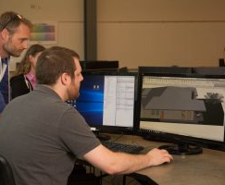
Student profile – KCTCS vs Universities
KCTCS students are more likely to be the first person in their family to attend college (55% vs 33%)
have dependents (34% vs 8%),
have a household income less than $20,000 (35% vs 18%),
and be 25 or older (32% vs 12%).
Roughly half our students are in technical programs and half in transfer programs
76% receive financial aid (68% paid 0 tuition)
56% are unprepared for college-level coursework

Slide 5
COVID IMPACT
Had to teach out 8,000 students in technical programs with lab components in Spring 2020 (Governor made special allowance)
Enrollment down 12% Fall 2020
Enrollment down 14.5% Spring 2021
Will students come back?
Will faculty and staff want to come back?
Slippery slope right now with exceptions
Daycare issues
K-12 finally face-to-face
Not everyone vaccinated

Slide 6
Impact to students
Survey of our students and call campaigns
Many students had to stay home with their children who were in online classes
Lost their jobs
Had housing and/or food insecurity
Had transportation issues
Didn’t have access to broadband
Had to help support their family or extended family
We’ve issued over $20m for just food and housing insecurities in CARES and HEERF so far

Slide 7
From CIO perspective
Parking lot Wifi projects at 58 locations
Retrofitted/upgraded thousands of laptops/desktops that were headed to Govdeals
Negotiated low price laptop configuration w/ Dell
WiFi hotspots loaned out
Moved thousands of face-to-face courses online to our hosted Blackboard environment
Supercharged Microsoft Teams Project
Entire workforce went remote, heavy usage of VPN (and terrified CISO)
Finally proved that telecommuting works for many to some of the “old school” managers

Slide 8
Presidential Transition Timeline
July 2020 – Interim President duties begin gradually moving to me
September 2020 – Dr. Jay Box retires
October 2020 – I’m serving as Interim President
April 21 – next President selected (3 finalists including myself)

Slide 9
Lessons Learned
Get rid of standing meetings with no agenda
Everyone wants your ear, need to carefully guard/prioritize your time
With 16 college presidents, PR/Marketing, and Cabinet – very difficult to triage what’s important
Parents and students feel very comfortable calling and emailing you
Legislators will take any occurrence and generalize it
They don’t want to hear about our budget woes

Slide 10
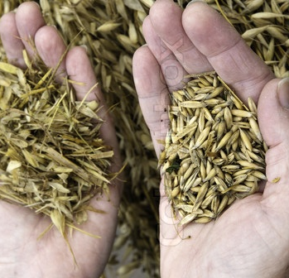
Lessons Learned 2
There haven’t been many surprises, the role is what you think it is
The most effective direct reports are laser focused with their updates/ requests, separate the wheat from the chaff – end up being funded more often
Need a mindset that there is no time to be new
Faculty and staff want to hear from you – videos, newsletters
Mental health resources for students, faculty, and staff is more critical than ever
Need to communicate with your Board and Board chair early and often
We have had Teams meetings since June 2020, finally having face-to-face in June 2021

Slide 11
What’s Keeping ME up at night
The coming wave of underprepared high-schoolers in fall 2021
Free community college: scalability and expectations
An underprepared student is an underprepared student
Compensation – we’re falling behind and losing some of our best faculty and staff
Talent management –need to attract new talent and plan for successions, over 40% of our faculty and staff can retire now
Polarized boards appointed by very different Governors
50% of our Board turning over in September

Slide 12
Questions or Discussion?
Thanks - PC

